Slide 1
Solvency II and Predictive Analytics in LTC and Beyond
How U.S. companies can improve ERM by using Advanced techniques developed for solvency II and emerging predictive analytics methods
Howard Zail, FSA, FFA, MAAA Partner, Elucidor, LLC hzail@elucidor.com
Nefissa Sator, CERA, MAAA, IA (French Institute of Actuaries) SVP USA for Forsides Actuary nefissa.sator@forsides.com

Slide 2
Presenters
Howard Zail, FSA, FFA, MAAA Partner, Elucidor, LLC hzail@elucidor.com
Nefissa Sator, CERA, MAAA, IA (French Institute of Actuaries) SVP USA for Forsides Actuary
Co-chairperson of the joint SOA / IA LTCI workshop nefissa.sator@forsides.com

Slide 3
Framework of Our Talk
ERM
Solvency II Framework
Advanced Predictive Analytics

Slide 4
Using Solvency II Techniques to Develop A U.S. ERM Program

Slide 5
Introduction
Why the subject of LTC ?
Social issue
Uncertainties about the extent of the future situation
Relatively new risk
High potential of business development for insurers
Facing this long term, evolving, and still relatively unknown risk, the ERM approach contributes to
Manage the risks
Determine the Solvency Capital Requirement
Design the future products
We will be discussing Solvency II / ERM in the context of LTC, but the application can be broadly applied across other life businesses

Slide 6
French LTC Market, the Big Picture
The first contracts were issued in the mid 1980s
About 25 insurers participate in the market
Most business is heavily reinsured
Product structures include
Stand-alone individual LTC with life-time benefits
Group policies with fixed benefit period or lifetime options
LTC Riders attached to other life products
LTC embedded with health products
Second largest market in the world after the U.S.
5.7 million of insureds
€660 million of which 75% is generated by traditional insurance companies
Paid claims around €236 million per year, 24,700 claims (annuities) in service
Technical reserves estimated about €4.6 billion

Slide 7
Solvency II Increases Capital Requirement by 12x
Solvency II does not provide explicit technical specification for LTC
Stress tests not calibrated for LTC
No correlation between longevity and disability risks
No Entity Specific Standard Formula yet developed and implemented
This results in a much higher capital requirement
Solvency II Capital = 12 x Solvency I Capital
ERM process is critical
to produce profitable business

Slide 8
Source of Solvency Capital Requirement (SCR)
Source | % of Underwriting SCR
Mortality | 0%
Longevity | 47%
Disability | 45%
Expenses | 1%
Lapses | 7%
Total | 100%

Slide 9
Governance and Risk Management, Pillar 2
2
Define the Key Risk Indicators
1
Identify the Risks
3
Determine the Management Actions
4
Develop an Adapted Risk Culture
5
Optimize the Risk Reduction Measures
BOARD
Risk Committee
LTC Experts committee

Slide 10
1. Identify the Risks
Evolution of regulation
Anticipate
Participate in the market debate Market watch Scenario-based valuation
Reputation
RISK
Prevent
Client communication Follow-up of client complaints Gradual pricing increase over years
Basis RISK
Monitor
Organize the portfolio experience return
Model RISK
Reduce
Documentation, Control, Audits
Sensitivity tests
Outsourcing RISK
Limit
Write service agreements and guidelines
Control

Slide 11
2. Define the Key Risk Indicators
Essential element ‘the data’
KEY RISK INDICATORS ‘KRI’
Mortality and Incidence Rates
Lapses and Non-Forfeiture
Discount Rates
Underwriting and Claims Acceptance
High budget necessary
Monitor the technical, financial and management risks
Justify assumptions
Alert in case of surpassing limits and correction measures
Reporting to the “LTC Experts Committee” and “Risk Committee”

Slide 12
3. Determine the Management Actions
Define the premium rate increase policy
Based on the key risk indicators
Taking into account the insured behavior
Using the long-term duration of the contracts
Reintroducing benefit revaluation
Reduce the reputation risk
Confirm the assumptions
Indexed premium + revaluation of benefits in a long-term process

Slide 13
4. Develop an Adapted Risk Culture
Relevant and efficient communication at all levels, with illustrations
Transform the KRI in visual indicators easily understandable
Illustrate the risk characteristics
Traffic light symbols to communicate the claims experience
Breakdown of the liabilities by age of occurrence
1/3 of the incidence rate is not yet observed

Slide 14
4. Develop an Adapted Risk Culture
Provide figures for the 2 components of the Active Lives Reserve
Change the risk culture
The company, the sales force and policyholder should expect annual premium increase like in health insurance or P&C.
In the French market, LTC is a long term policy but with non-life premium mechanisms.

Slide 15
5. Optimize the Risk Reduction Measures
Other monitoring tools
Reinsurance
Increase ceded shares
Transfer risk and reduce capital needs
The Reinsurer brings expertise (can not be considered Best Estimate)
Pay attention to the treaty wording
Diversification with other risks
Package LTC and death risk
Additional reserves ‘Equalization Reserve’
Maintain even if not recognized by Solvency II
Constitutes equity
Monitoring tool for short and mid-term evolutions and earnings

Slide 16
Conclusion
Solvency II increases Capital by 12x
This necessitates an ERM process to ensure long-term viability of the business
ERM, in turn, improves future product development and company embedded value

Slide 17
Using New Advanced Predictive Analytics Techniques within an ERM Program

Slide 18
What are Predictive Analytics?
Machine Learning / Pattern Recognition
Actuarial Science / Statistics
Algorithms / Modeling
Professional
Experience / Insight
Predictions
Prior Information
Improved
Insight
Data

Slide 19
What is Different Now?
New Players
Improved Algorithms and Techniques
More Powerful Hardware
Vastly Improved Software
Profoundly Improved Analytics

Slide 20
Using Predictive Analytics in a U.S. ERM Program
Internal Risk Model
Level of Risk
Volatility of Risk, Correlation among Risks

Slide 21
Our Focus Today
There are many methods, techniques within Predictive Analytics toolbox
We will focus on one very powerful, flexible technique which has broad application:
State Space Modeling

Slide 22
State Space Modeling
State Space Modeling
Interest Rate Risk
Longevity
Internal Risk Model
Level of Risk
Volatility of Risk, Correlation among Risks

Slide 23


A Battle Ships Game Analogy
State_{t} =
Actual Position of Ship at time t
t
t+1
Observation_{t} =
Noisy Radar Reading at time t

Slide 24
A Bayesian Network Representation
State₁
State₂
State₃
State
Obs₁
Obs₂
Obs₃
Observation

Slide 25
Solving the Model
The techniques used to solve state space models are often not trivial
But, there is extensive literature to help
Our preferred method:
Full Bayesian Model, solved using Markov chain Monte Carlo techniques
Advantages:
Provides a complete solution
Method is adaptable across many projects
Disadvantages:
Requires lots of computing power (and potentially time)

Slide 26
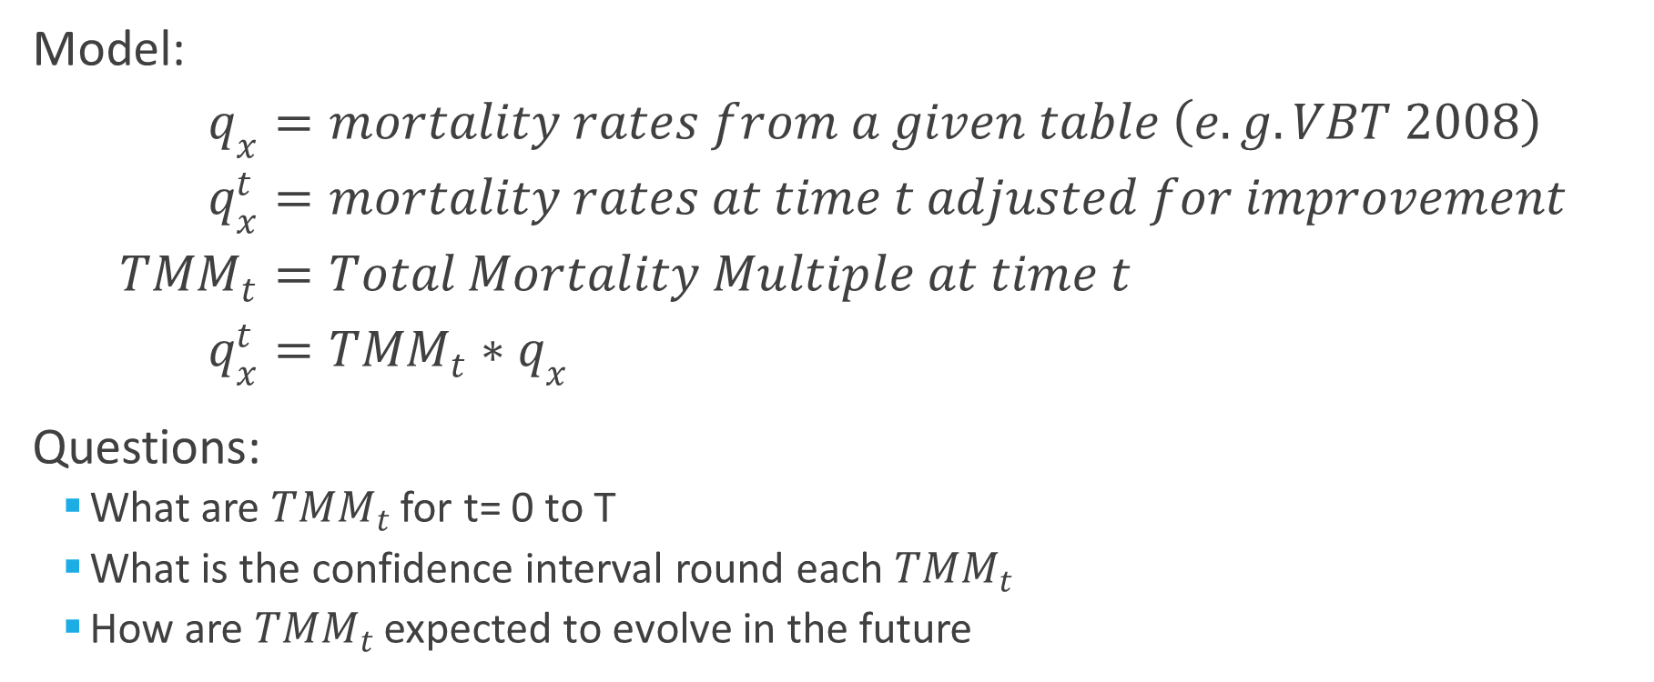
A Longevity Risk Analysis Example
Model:
$$q_{x}=mortality rates from a given table \left(e.g. VBT 2008\right) \\ q_{x}^{t}=mortality rates at time t adjusted for improvement \\ {TMM}_{t}=Total Mortality Multiple at time t \\ q_{x}^{t}={TMM}_{t}∗q_{x}$$
Questions:
What are ${TMM}_{t}$ for t= 0 to T
What is the confidence interval round each ${TMM}_{t}$
How are ${TMM}_{t}$ expected to evolve in the future

Slide 27
Longevity Risk State Space Representation
TMM₀
TMM₁
TMM₂
State
Deaths & Survivals₀
Deaths & Survivals₁
Deaths & Survivals₂
Observation

Slide 28
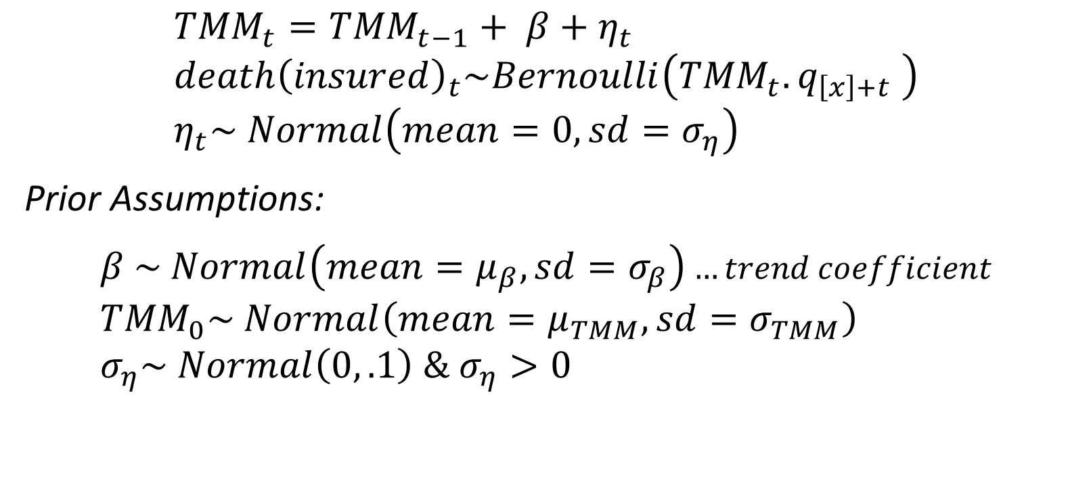
The Full Bayesian Longevity Model
State
$${TMM}_{t}={TMM}_{t−1}+ β+η_{t} \\ {death\left(insured\right)}_{t}\sim Bernoulli\left({TMM}_{t}.q_{\left[x\right]+t} \right) \\ η_{t}\sim Normal\left(mean=0, sd=σ_{η}\right)$$
Prior Assumptions:
$$β \sim Normal\left(mean=μ_{β}, sd=σ_{β}\right)…trend coefficient \\ {TMM}_{0}\sim Normal\left(mean=μ_{TMM}, sd=σ_{TMM}\right) \\ σ_{η}\sim Normal\left(0, .1\right) \& σ_{η}>0$$
Observation
* The above model is somewhat of a simplification to the one we use in practice but is useful for pedagogical purposes

Slide 29
Hypothetical Example
Background:
50,000 Insured lives, male and female, aged 40 to 60
Followed for 10 years
True (but unknown) Mortality:
90% of 2008 VBT at issue (TMM₀ = 90%)
Mortality Improvement = 1% p.a. for 4 years, 2% p.a. thereafter
Approach:
Simulate Mortality based on true mortality
Use State Space Model on simulated outcomes to “reverse engineer” true mortality

Slide 30
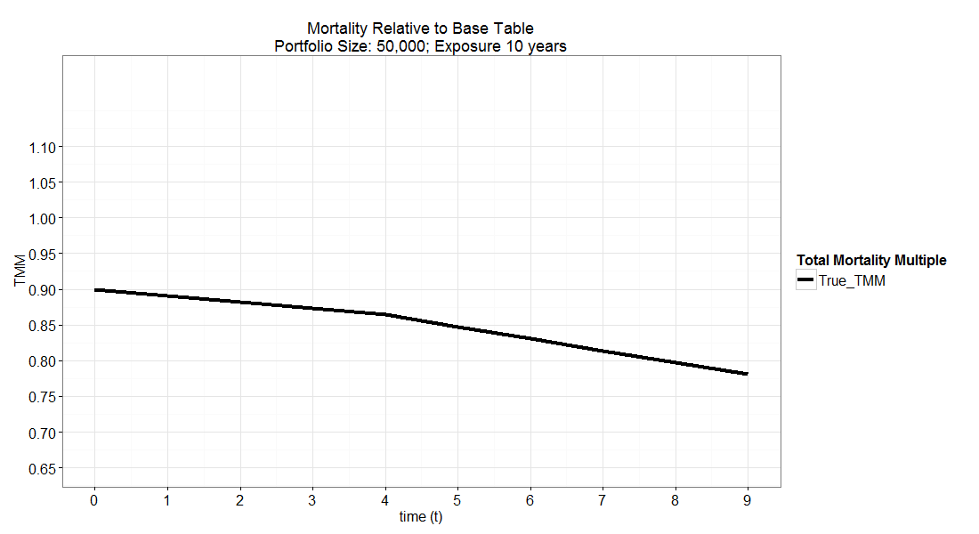
Assumed Mortality Assumptions

Slide 31
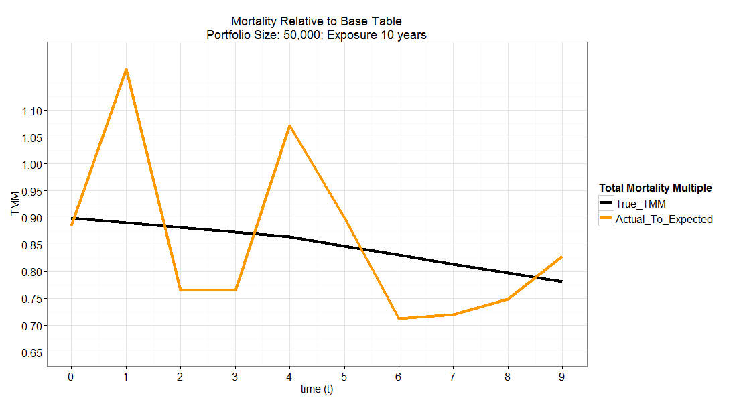
Simulated Mortality

Slide 32
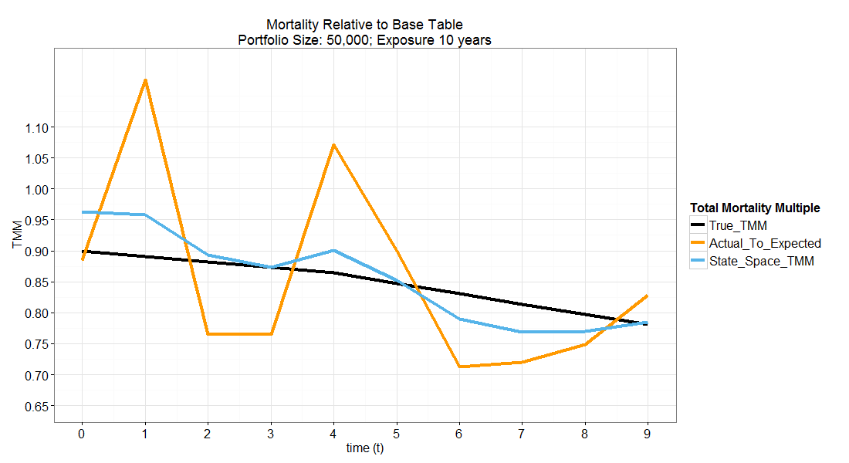
State Space Model

Slide 33
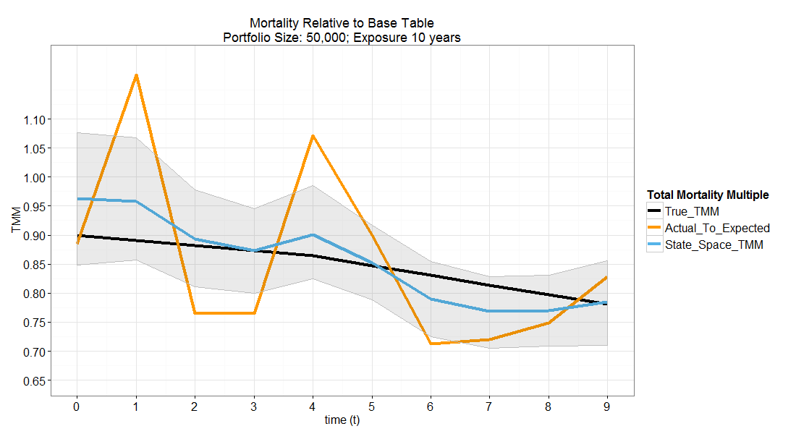
State Space Model with 10% to 90% Confidence Interval

Slide 34
Advantage of the State Space Approach
We now understand how mortality has evolved over the investigation period
State space terminology: “smoothed” set of TMM states
We have a best estimate for the current level of TMM rather than an average over the investigation
State space terminology: “filtered” TMM states
We know the average trend in mortality improvement, and the uncertainty/volatility of this estimate
We know what the confidence interval of our estimates for the current TMM
The confidence interval shrinks with more data (deaths)
We can project TMM going forward with a data driven estimate for the volatility (uncertainty) associated with
Current TMM value; Improvement Trend
We do not need to guess as to what reasonable sensitivity test level should be

Slide 35
An Interest Rate Risk Example
Motivation:
Duration-based ALM encapsulates parallel changes in yield curve well, but not changes in shape of the yield curve
Many arbitrage-free models do not show good historical empirical fits to the data
Uncertainty as to how to estimate the degree of volatility in interest rates when setting capital levels

Slide 36
State Space Approach to Interest Risk
Fit a Parametric Curve to Yield Curve at each point in time
Nelson-Siegal Model
Adopt a dynamic approach to model
Use a state space to represent changes in the parameters of the Nelson Siegal Curve
Implement in ERM
Use same model to project yield curve going forward to estimate interest rate risk exposure

Slide 37
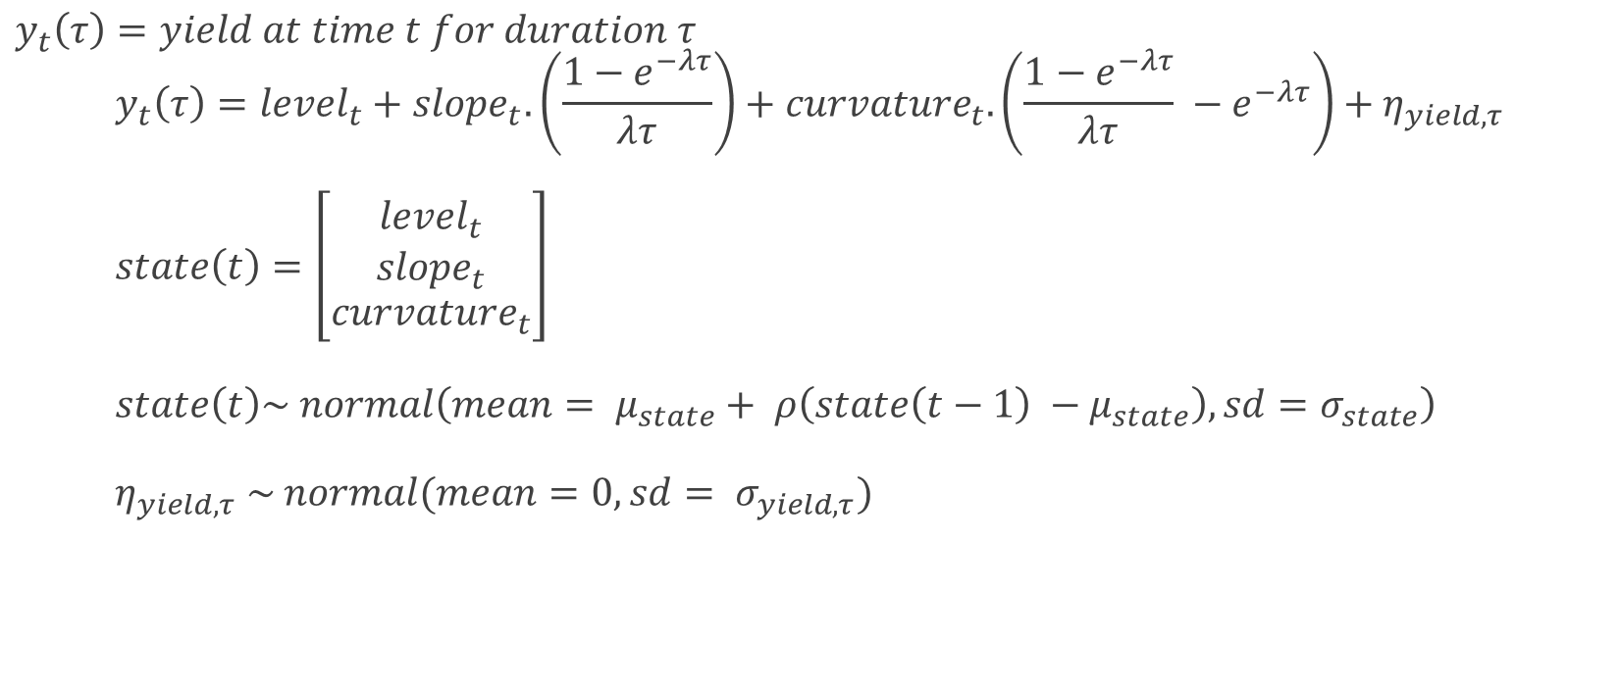
The Dynamic Nelson-Siegal Model
$y_{t}\left(τ\right)=yield at time t for duration τ$ $y_{t}\left(τ\right)={level}_{t}+{slope}_{t}. \left(\frac{1−e^{−λτ}}{λτ}\right)+{curvature}_{t}.\left(\frac{1−e^{−λτ}}{λτ} −e^{−λτ}\right)+η_{yield, τ}$ $state\left(t\right)=\left[\begin{aligned}\begin{matrix}{level}_{t} \\ {slope}_{t}\end{matrix} \\ {curvature}_{t}\end{aligned}\right]$ $state\left(t\right)\sim normal\left(mean= μ_{state}+ ρ\left(state\left(t−1\right) −μ_{state}\right), {sd=σ}_{state}\right)$ $η_{yield, τ} \sim normal(mean=0,{sd= σ}_{yield, τ})$

Slide 38
Interest Risk State Space Representation
Level, Slope, Curvature₁
Level, Slope, Curvature₂
Level, Slope, Curvature₃
State
Yield Curve₁
Yield Curve₂
Yield Curve₃
Observation

Slide 39
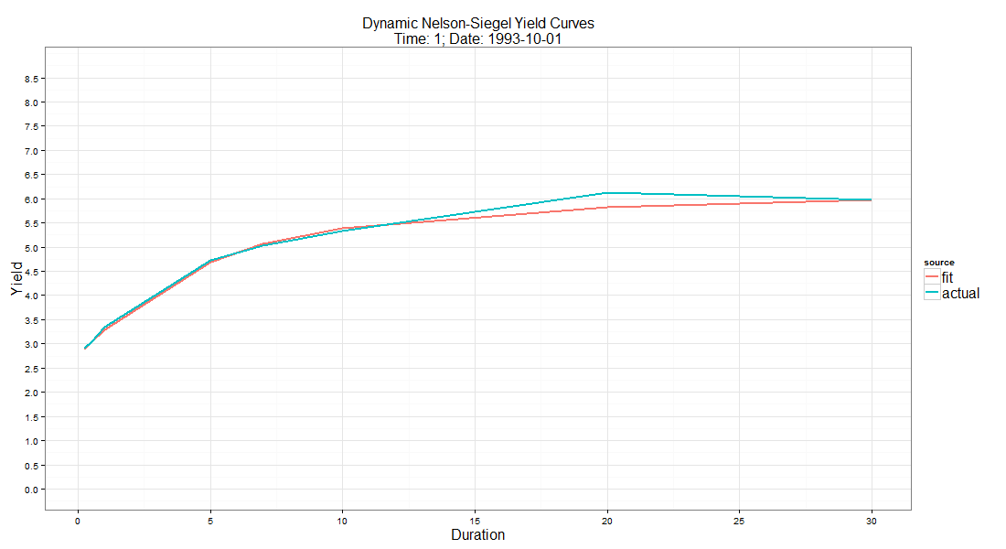
Historic Dynamic Fit of Model
Press Shift F5 to view dynamic fit

Slide 40
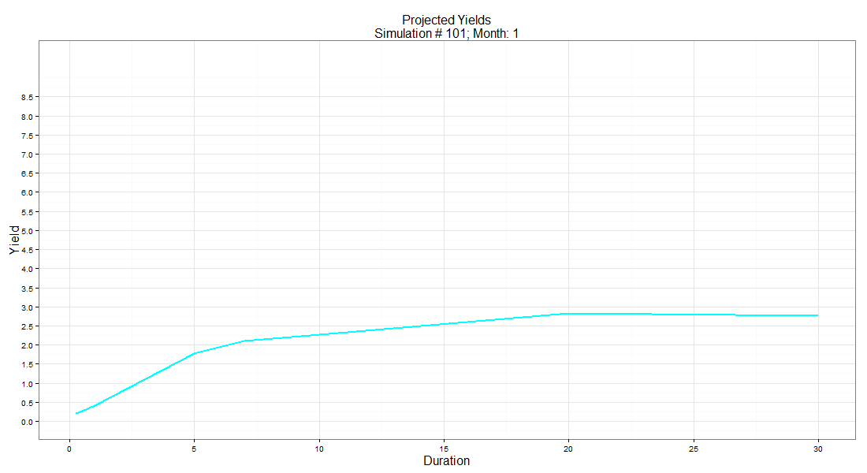
Yield Curve Projections
Press Shift F5 to view dynamic fit

Slide 41
Possible Extensions to the model
Regime Switching: Include a “regime” change element to reflect the fact that current rates are at a historic low and that there is a reasonable risk that rates will revert to prior, higher levels.
Dynamic λ: Include λ in the state space. This parameter sets the point of maximum curvature of the yield curve
Dynamic Volatility: Allow for changing volatility to represent periods of higher uncertainty
Multi-country: Include multi-country yield curves in model so as to assess correlation of cross-border interest rate risk
Credit Spreads: Include spreads in the model to allow for dynamic modeling of credit spread risk

Slide 42
Advantages of the State Space Approach
We are able to match asset and liabilities by hedging:
Changes to the level of interest rates
Changes to slope of yield curve
Changes to the curvature of yield curve
We have a distribution of possible future yield curve paths and shapes
We can simulate future changes in yield curves using a model that is consistent with historical data
We can create confidence limits on our projections and justify these limits:
No need to guess at sensitivity scenarios
Simulation projections allow for concurrent changes in Level, Slope, Curvature

Slide 43
Summary
ERM requires a well-developed infrastructure and company-wide implementation
General approaches developed under Solvency II can be used in the U.S.
ERM includes both business management and technical analysis which need to be well integrated
Without standard capital margin formulae, U.S. companies need powerful and flexible predictive analytics to quantify risk and volatility
State Space Modeling is one such tool that offer greater insights into many of an insurer’s risk
It has broad application
Provides insight into level, volatility and direction of risks

